Slide 1

Forecasting Interactions Between ENSO and Extreme Drought with Recurrent Neural Networks
Justin LE¹, Hesham EL-ASKARY²
Chapman University Schmid College of Science and Technology (California, US)
AOGS 2016 (Jul 31-Aug 05), Beijing, China
¹jusle@chapman.edu; ²elasakary@chapman.edu
Slides available at https://github.com/mstksg/talks/tree/master/aogs-2016
Notes:
Paper is currently under review, submitted to Atmospheric Research! Hesham El-Askary could not be present.

Slide 2
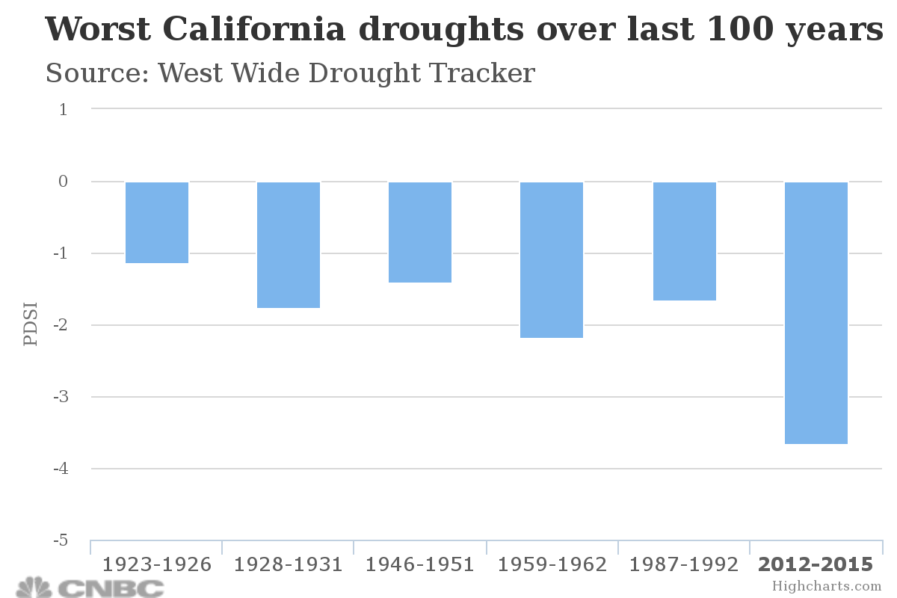
2012 California Drought
The 2012-present California Drought has been the most extreme drought in the region’s recorded history.
Short-term impacts:
Hydropower, recreation, farm yields
Long-term impacts:
Permanent groundwater loss, wildfire risk, land elevation sinking, seawater intrusion, ecological disruption
$2.2 billion dollars of economic loss in 2015

Slide 3
El Nino Southern Oscillation
ENSO is a global phenomenon impacting different regions in the world in different ways.
In California (and most of the US), El Nino seasons manifest as periods of extreme rainfall, flooding, and warm temperatures
Strong El Nino seasons bring economic damage
In 1997-1998, the US suffered $25 billion in economic loss.

Slide 4
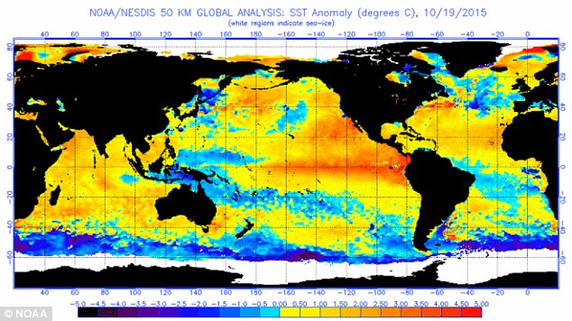
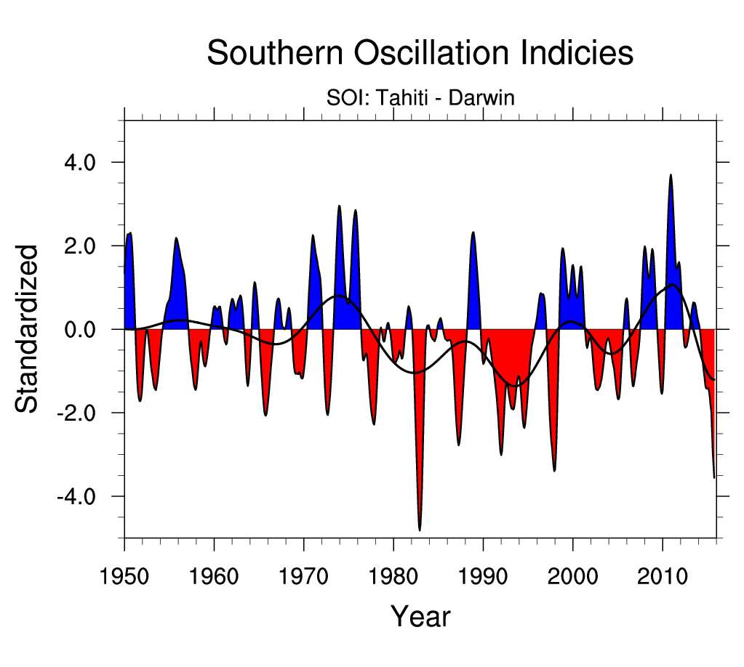
2015-2016 El Nino Season
How does El Nino manifest? What did we see going into 2016?
Notes:
El Nino is typically seen as warming period in the pacific ocean off the coast of South Africa. The SOI is typically used to track the ENSO cycle. In both cases, going into Winter 2016, it seems like El Nino is going to be huge.

Slide 5
Let’s Go back to Summer 2015
In the weather community and popular media, the 2015-2016 El Nino Season was hailed as a savior to bring California out of drought.
With SOI (Southern Oscillation Index) and ONI (Oceanic Nino Index) indicated strong seasons, many forecasted extreme precipitation.
But what happened?

Slide 6
What happened in California Winter 2016-2015?
Nothing.
Well, almost nothing.
Disappointing rainfall, and one of the driest winters in California history.
Reservoirs continue to deplete
Drought outlook has not changed.
Did anyone see this coming?

Slide 7
Questions
Can current Machine Learning research on “black box” classifiers give us any:
Predictive power on atmospheric phenomenon?
Physical insight into the phenomenon at work?
Can we apply them to projections on the California Drought?
Notes:
Machine Learning research is very active right now.

Slide 8
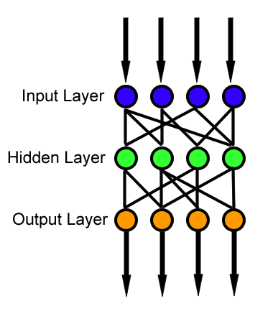
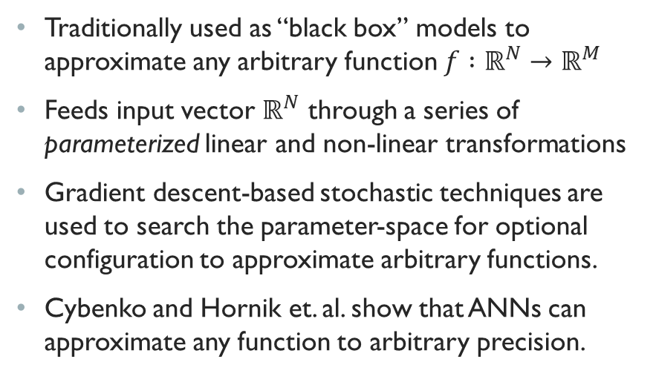
Artificial Neural Networks
Traditionally used as “black box” models to approximate any arbitrary function $f :ℝ^{N}→ℝ^{M}$
Feeds input vector $ℝ^{N}$ through a series of parameterized linear and non-linear transformations
Gradient descent-based stochastic techniques are used to search the parameter-space for optional configuration to approximate arbitrary functions.
Cybenko and Hornik et. al. show that ANNs can approximate any function to arbitrary precision.
Notes:
Feed-forward neural networks. Training a network involves picking the right parameters.

Slide 9
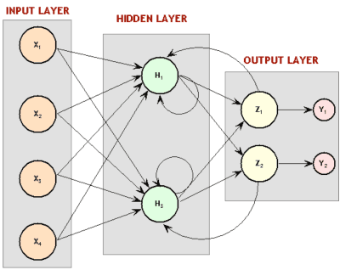
Recurrent Neural Networks
Traditional “feed-forward” neural networks can model static functions, but in weather, we often want to model dynamic processes.
Recurrent neural networks are a modification to traditional networks: instead of being parameterized functions, they are parameterized state machines.
Input and internal state are fed through a series of parameterized linear and non-linear transformations to produce “next result” and new internal state.
Gradient descent also employed to chose parameters.
Notes:
RNN’s more suitable because time series.

Slide 10
Recurrent neural Networks as Generative Models
Recurrent Neural Networks have had success in modeling dynamic processes and in generative models.
We can supply (monthly) climate indices and weather data history to the model, and ask it to predict the next month.

Slide 11
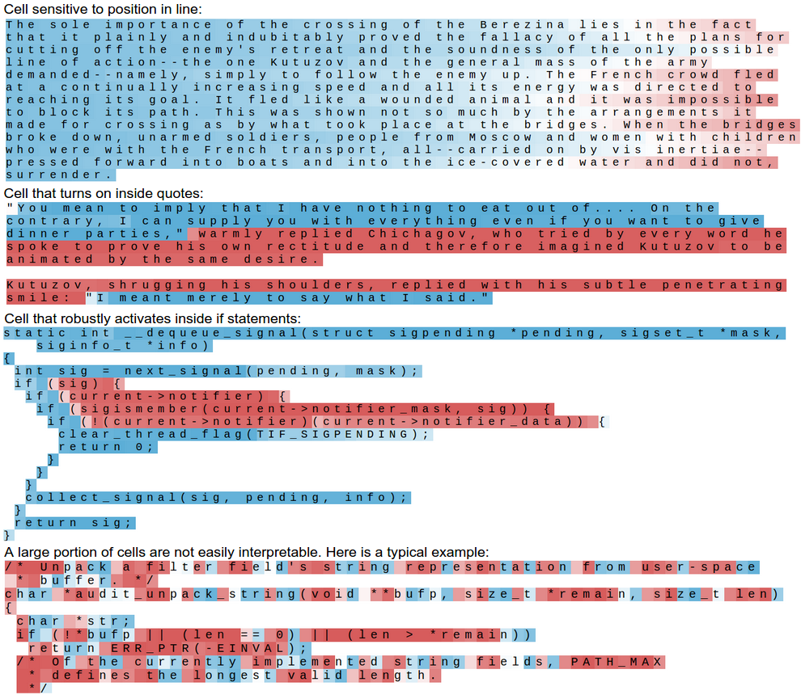
Internal Activation Yields Physical Insight
Karpathy et. al. attempted to use RNNs to predict the next character in a body of text, and to generate entire passages.
By tracking the internal progress of data transformations, he noticed that certain state components represented certain phenomenon in the text.
These state components were never explicitly programmed to behave in this way – they were automatically derived through stochastic gradient descent!

Slide 12
Model Data
We attempted to train the model as a purely autocorrelative model to predict the next month of weather indices based on recent observed indices.
The prediction is then taken as “observed data” and used to forecast two months ahead.
The process is repeated to extend the model to be able to look several months into the future.
NOAA NCDC’s nClimDiv data set for Southern California (US climate division 04-06) was used, which provided historical data on climate and weather indices for the previous 150 years.
After training, model is refined and input predictors are eliminated to increase model fitness.

Slide 13
Palmer Z Index
After investigating the success of the model based on input data, we decided to keep only three climate indices: (normalized) Temperature, Precipitation, and Palmer Z-Index (PZI)
The Palmer Z index (PZI) is an aggregate index based on monthly soil moisture, evapotranspiration, potential run-off, and other moisture-related indicators.
We found that the index successfully captures drought-like conditions and also monthly precipitation.

Slide 14
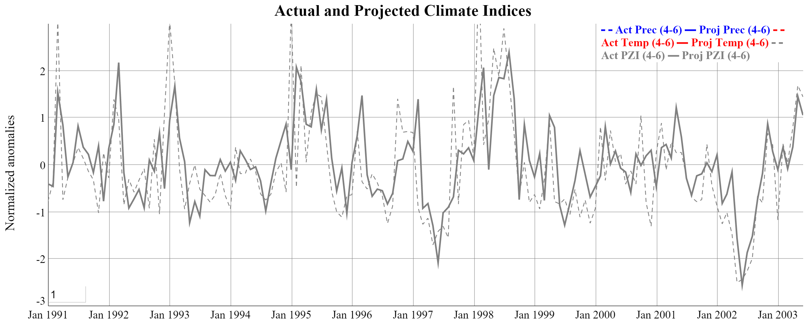
Results (Training Convergence)
Model successfully converges on training data, especially for the critical1997-1998 El Nino season.
Notes:
Training converges, but this is not a surprise.

Slide 15
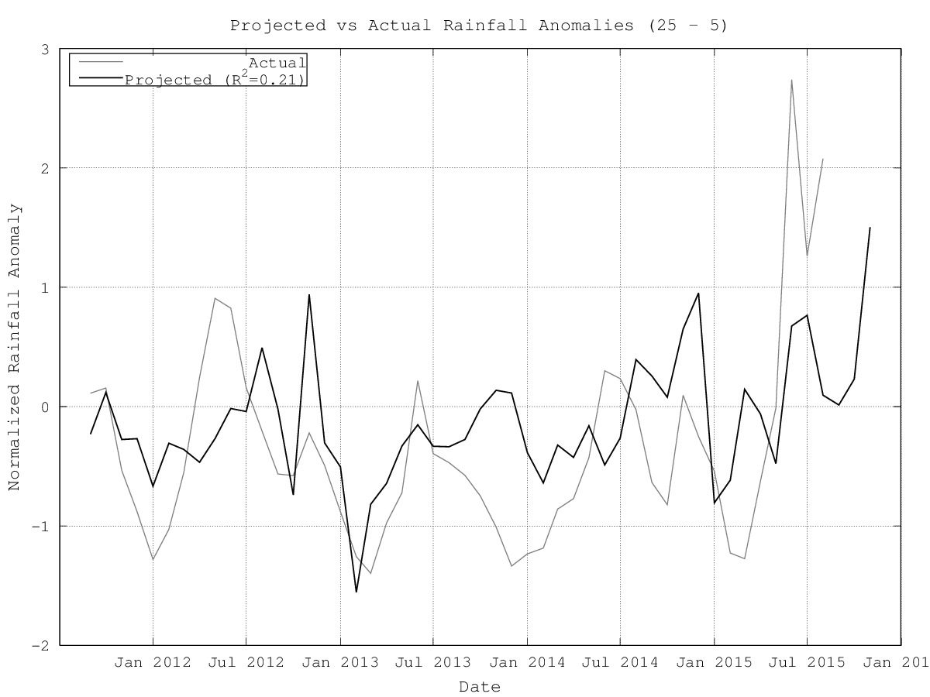
Struggles
The universal enemy of neural networks is overfitting, due to the sheer number of model parameters (often in the thousands or millions). Combatting overfitting is the subject of much active ANN research.
We applied several techniques to mitigate overfitting, including:
Noise injection
Stochastic gradient descent
“Dropout”-based techniques for ensemble simulation
Gradient-preserving activation functions
Unsuccessful validation of an overfitted model
Notes:
It’s bad, but neural networks all have to counter overfitting.

Slide 16
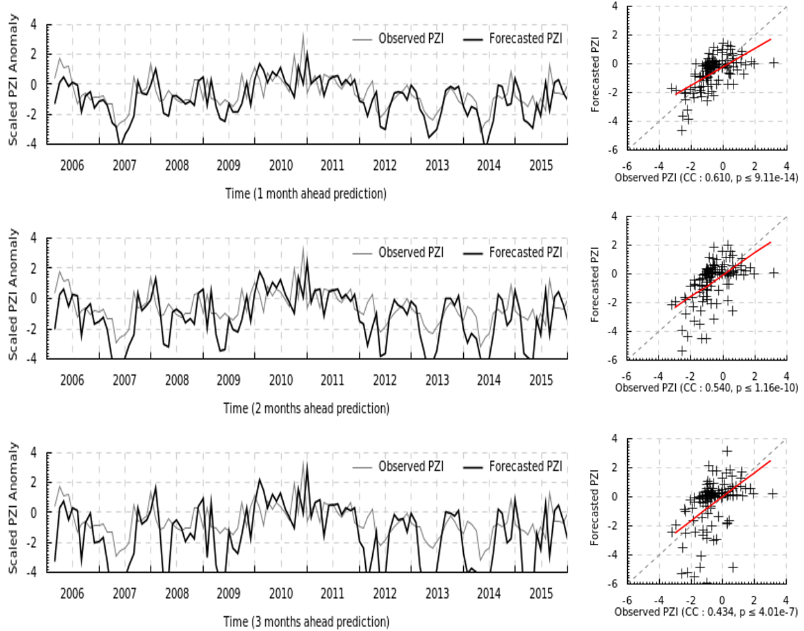
Results (Validation)
Model validates well on a data set unseen during training, with p value lower than one in one million for three month ahead predictions.
Correlation is significantly higher than simple moving-average or delay models.
Notes:
Model correctly anticipates jumps and declines, so it’s better than lagging and other models. Model has an apparent tendency to under-predict, but there are case when it overpredicts too.

Slide 17
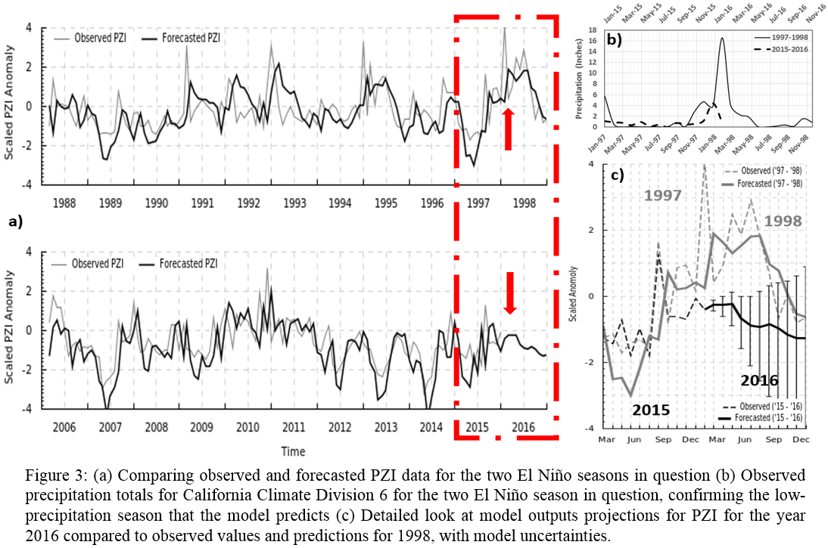
Projections
Applying the model to the future, it predicts continuing drought (and, consequentially, low precipitation) into mid 2016. Shown here is the comparison to the historic 1997-1998 El Nino Season. These projects were made February 2016. Available data from Mar to Jun confirm these projections.
Notes:
Model correctly anticpates jumps.

Slide 18
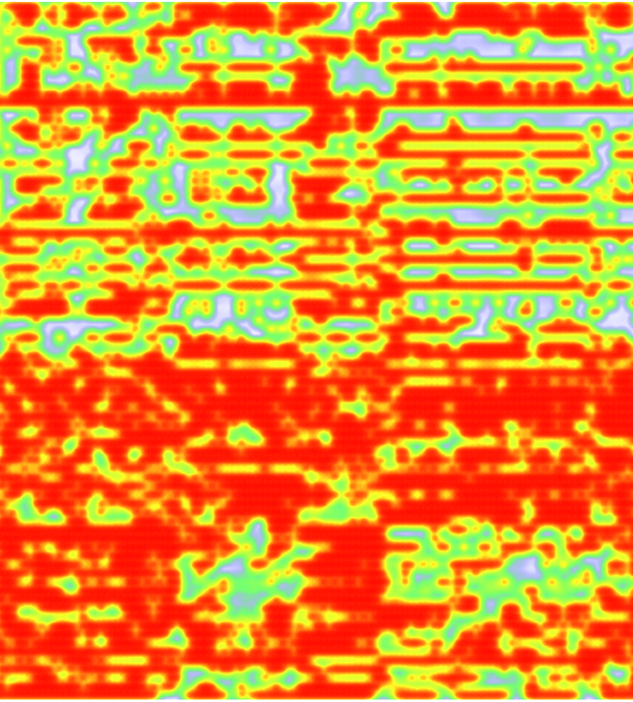
Internal Node Activation
With RNN’s, we have the privilege of being able to “peek inside” the internal state of the network as it processes data.
Here shown are the activations of internal “neurons” in a trained network over time. Each neuron models a specific aspect of the physics the network is attempting to model, and its roles are automatically defined through the stochastic gradient descent.
The most obvious pattern is the redundancies that the network builds to be robust to errors and noise.
What do these regions of high and low activation represent? What mysteries are hidden in their structure? Curiosity abounds.
nodes
time

Slide 19
Conclusions
The model was able to predict the dry season of continuing drought in California, despite all other contemporary predictions indicating high precipitation and recovering drought. It is among the rare few who were able to see it coming.
The projections on PZI have been confirmed for newly released data for Mar 16 – Jun 16.
Recurrent Neural Networks show promise for modeling dynamical processes in atmospheric sciences, despite being black boxes.
Countering their black box nature, we have clues and in-roads for deciphering their internal mechanisms from studying internal node activations over time – something impossible for traditional feed-forward neural networks.
Paper containing this work is currently under review.

Slide 20
Thank you
Special thanks to:
Chapman University Schmid College of Science and Technology
Asia Oceania Geosciences Society
NOAA and the NCDC for providing the nClimDiv data set used for model training and validation.
These slides available online at https://github.com/mstksg/talks/tree/master/aogs-2016

